Slide 1
Technical Communication MCAC105

Slide 2
Unit 1: Communication
Animal Communication and human communication,
Communication Models,
Verbal and non-verbal communication,
Speech and writing

Slide 3




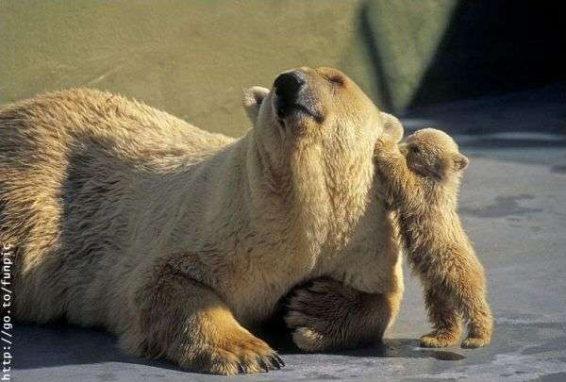
ANIMAL COMMUNICATION

Slide 4

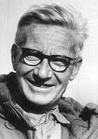
INTRODUCTION
Animal communication is the passage of information b/w two animals.
The animal which sends is called signaller and the animal that recieves signal is called reciever.
Animal communication is also known as Biological communication.
They can convey their needs, desires and reactions to the environment via some sophisticated signaling of their own.
The classical ethological view of communication was developed by Niko Tinbergen.
Niko Tinbergen

Slide 5

FUNCTIONS OF COMMUNICATION
Agonistic interaction – threat displays during competition over food, mates or territory
Ownership/territorality – to claim or defend territory
Food-related signals – to lead members of a social group to a food source
Alarm calls – to warn of a threat from a predator

Slide 6

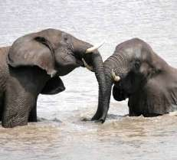
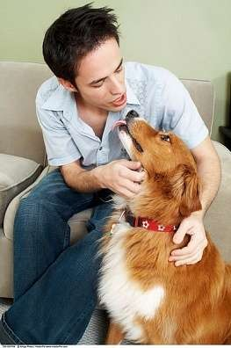
TYPES OF COMMUNICATION
Intraspecific communication
communication within a single species
Eg. Honeybee dance
Interspecific communication
Prey to predator
Eg. warning colouration in wasps
Predator to prey
Some predators communicate to prey to make them easier to catch, in effect deceiving them.
Eg. Angler fish
Human/animal communication
During domestication of animals

Slide 7

BASIC COMPONENTS
Signaller : An animal which emits signal.
Reciever : An animal which recieves signal
Signal : The behaviour emitted by the signaller
Channels : A pathway through which normally a signal travels. (ie means of communication)
Visual
Auditory
Chemical
Tactile
Electrical
Suface vibration

Slide 8

VISUAL COMMUNICATION
Information transmitted by visual means is called visual communication.
The visual signals may be given by various means
like
movement
posture or shape of the body
Facial expressions.
colour identification
light etc.
Visual signals are used most often by species that are active during day.
Light as a visual means is used in night.

Slide 9
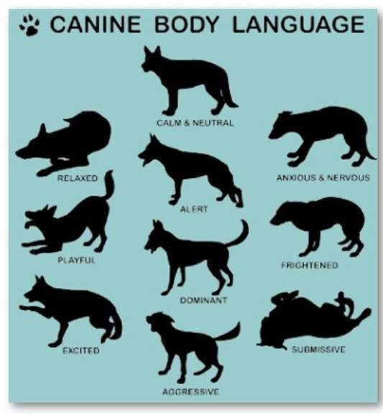
2) Postures
Some mammal species give specific signals by the position adopted by head, ears & tail.
Eg. Flattened ear – fear/ suspicion
Wagging of tail – Complete submission.
Retraction of lips to display teeth - threat display.

Slide 10
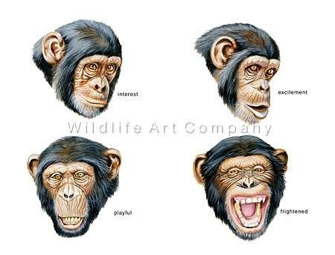
3) Facial expressions

Slide 11



5) Light (Bioluminescence)
Certain insects and deep sea fishes communicate via their light signals.
Luminuous insects are glow worms and their relatives the fireflies.
Eg. of light producing fish includes Anglerfishes
Fireflies.
Glow worms
Anglerfishes

Slide 12

AUDITORY COMMUNICATION
Sending information from one member to another by sound production is called auditory signal or bioacoustic signal.
Sound is a good means of communicating over long distances both in air and water.
Sound is more effective signal at night and darkness

Slide 13




EXAMPLES
Deathwatch beetle signal to each other by producing clicking sound made by tapping their head against wood.
Red squirrels will make a series of loud rattles and screeches to warn off intruders.
The bottlenose dolphin has a wide range of vocalizations. Each dolphin also has its own unique whistling sound that it uses to identify itself.
Deathwatch beetle
Red squirrels
Bottlenose dolphin

Slide 14
ODOUR OR CHEMICAL COMMUNICATION
Molecules used for chemical communication between
individual animals are called pheromones.
Pheromones are involved in marking territory, alarm spreading etc.
Odour signals can transmit informations in dark, can travel long distances, can last for hours or number of days.
Chemical messages that pass between animals of the same species.
Chemical communication is the most primitive type of communication.

Slide 15
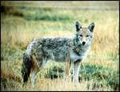
EXAMPLES
Alarm pheromones are produced in ants in the form of
formic acid to protect themselves from enemies.
Ants lay down an initial trail of pheromones as they return to the nest with food.
Dogs and some other animals of dog family use urine to mark the boundaries of their territories.

Slide 16



TACTILE COMMUNICATION
Information transmitted in the form of physical contact
(touch signal) is called tactile communication.
Antennae of ants, termites and honeybees are involved in
this process
Eg. 1) Female primates often hold and frequently cuddle their young kids. Helps in establishing a bond between them
2) Termites – blind workers totally
depend on this phenomenon.
Two worker ants in tactile communication

Slide 17


ELECTRICAL SIGNALS
It is a means of communication in some fishes.
Torpedo (Electric ray), and sharks (Scyliorhinus caniculus) have electro receptors that they use in communication.
Sharks detect the electric field produced by prey flatfish that are buried in the sand by a specialized organ called the ampulla of lorenzini.
Electric fish communicate information about species identity by discharging electric field.

Slide 18


SURFACE VIBRATIONS
In some animals information may be communicated by patterns of surface vibrations.
Eg. Water spider send out ripples of certain frequency and receptive female respond by moving towards the source.

Slide 19
Human Communication

Slide 20
Definition
Newman & Summer:-
" Communication is an exchange of facts, ideas, opinions or emotions by two or more persons.”
Louis A. Allen:-
“Communication involves a systematic and continous process of telling, listening and understanding.”
Hudson:-
“Communication in its simplest form is conveying of information from one person to another.”
Elliott Jacques:-
“The sum total of directly and indirectly , consciously & unconsciously transmitted feeling, attitudes and wishes”.

Slide 21
Forms of Human Communication:
Intrapersonal Communication
Interpersonal Communication
Interviewing
Small Group Communication
Organizational Communication
Public Speaking
Computer-Mediated Communication
Mass Communication

Slide 22
TYPES OF COMMUNICATION
Formal Communication
Informal Communication
Written Communication
Oral Communication

Slide 23
Benefits of Human Communication:
Critical and creative thinking skills.
Interaction skills.
relationship skills.
Leadership skills.
Presentation skills.
Media Literacy skills.

Slide 24
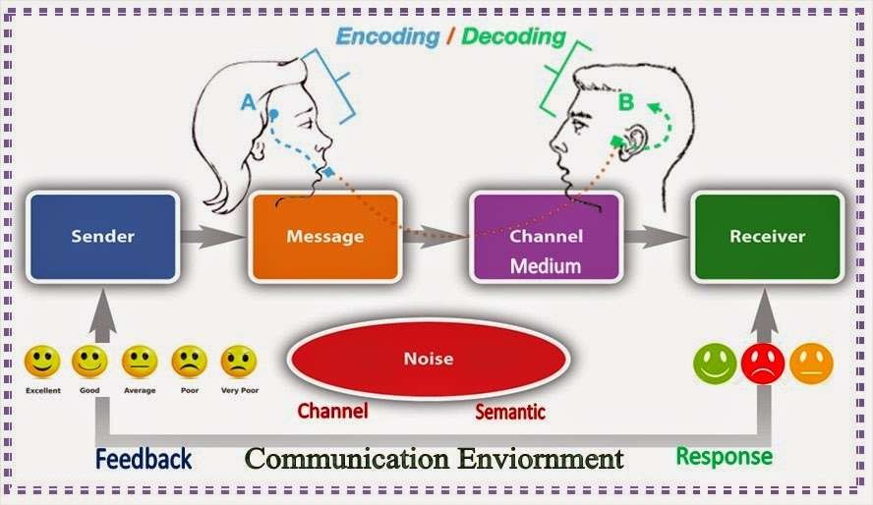
Elements of Human Communication

Slide 25








Principles of Human Communication
Purposeful
Inevitable, irreversible, Unrepeated
Transactional
Punctuated
Package of Signals
Ambiguous
Content &Relationship
Process of Adjustments

Slide 26
PRINCIPAL OF COMMUNICATION
Know your audience.
Know your purpose.
Know your topic.
Anticipate objections.
Achieve credibility with your audience.
Follow through on what you say.
Communicate a little at a time.
Present information in several ways.
Develop a practical, useful way to get feedback.
Use multiple communication techniques

Slide 27
PRINCIPLE OF EFFECTIVE COMMUNICATION
Simple Language :
The language used in communication should be simple and easy understandable. Simple language means using familiar words.
No ambiguity :
The communicator should be clear in his mind about the objective of his communication.

Slide 28
Proper medium of communication:
The communicator should select the proper medium by considering such factors as the nature of matter to be communicated urgency
of communication, distance
the
between the recipient of
communicator and
communication etc.
Adequacy of information :
– In order to make communication effective , one more condition to be fulfilled is that is should be adequate and complete in all respects.

Slide 29
Right climate in the organization:
their should not be any communication barriers in the business corner.
the organization structure of the unit concatenating of physical settings and human setting must facilitate the process of communication.
Training to the communicators:
Proper training should be given to the communicators in the communication skills this helps in interesting the effectiveness of
communication considerable

Slide 30
Purpose of communication:
The basic purpose of any communication is to elicit a behaviourial response from the receiver.
The sender or communicator must make efforts to achieve the objective of this response.

Slide 31
Consultation:-
It is necessary to seek the participation of others in planning a communication.
It helps the sender to get additional insight into &
objectivity participate
of the message. & help
Moreover, those who
give
communication planning will
active support to you.
Content of Message:-
The communicator should decide his tone of voice with reference to the content of the message.
Sometimes, the communicator may make his voice loud
or shrill in order to make the communication effective.

Slide 32
Follow-up action:-
Follow up action is necessary to find out whether the receiver has understood the message correctly.
The receiver may take some action after receiving the message. The sender should know the type of action taken by the receiver.
Time & opportunity:-
The sender should consider the interest & needs of
the receiver of message.
It helps him to find out the correct time when the message is to be communicated.
In this way, the sender uses the opportunity to convey
the message for enduring & immediate benefits to the

Slide 33
Training to the communicators:-
Proper training is essential to the communicators to develop their communication skills.
This helps in increasing the effectiveness of
communication considerably.
Action support communication:-
The actions or attitudes of the sender should support the message. For example, the sender may raise his hand to convey the message of „ stop the work‟.
So, the actions of the sender should not contradict his

Slide 34
Personnel co-operation:-
– Co-operation of the personnel is necessary to make effective communication.
– The communication results
in strengthening the the co-operation of
business concern through
managerial personnel.
Listening:-
Listening is one of the most important tasks of the sender.
Here, listening refers to the reactions of the receiver.
The sender must learn to listen with the inner ear.
The sender can gather useful information through listening for further communication.

Slide 35


Introduction to Public Speaking
In public speaking a speaker presents a relatively continuous message to a relatively large audience.
Public speaking is transactional.
The listeners also send messages in the form of feedback (applause, nods, looks, etc. )

Slide 36


The benefits of public speaking
Improve your Public Speaking abilities
Improve your personal and social abilities
Improve your academic and career skills

Slide 37

Essential steps for preparation an effective public speech
1- Select your topic, purposes
2- Analyse your audience
3- Research your topic
4- Collecting supporting materials
5- Develop your main points
6- Organize your
speech materials
7- Construct your introduction, conclusions, and transitions
8- Word your
speech
9- Rehearse your
speech
Present your
speach

Slide 38
Comparison of Human and Animal Communication
Similarity: Both are composed of SIGNS (forms with meaning)
Key Differences:
-------------------------------------------------------------------------
Animal: The signs of animal systems are inborn.
Human: The capacity to be creative with signs is inborn, but the signs (words) themselves are acquired culturally.
Animal: Change extremely slowly, with the speed of
genetic evolution.
Human: Change rapidly as a cultural phenomenon.
Animal: Each sign has one and only one function; each meaning can be expressed only in one way
Human: Signs often have multiple functions; one meaning can be expressed in many ways

Slide 39
Animal: Not naturally used in novel way
Human: Creative, can be adapted to new situation
Animal: Closed inventory of signs; only a set number of different messages can be sent
Human: Open ended. Grammar (rules of syntax) allows a virtually unlimited number of messages to be constructed
Animal: Communication is set responses to stimuli.
Human: Not limited to use as an stimuli.

Slide 40
Models of Communication

Slide 41
Models of Communication
Linear Communication Model:
It is a simple one way communication model. The message flows in a straight line from sender to the receiver. There is no concept of feedback. The only task that a receiver does here is to receive the message.
Aristotle’s Model
Berlo’s SMCR Model
Shannon & Weaver Model
Transactional Model: Here, senders and receivers both are known as communicators and both play equally important role in communication. Transactional model relates communication with social reality, cultural up-bringing and relational context (relationships). Non- verbal feedback like gestures, body language, is also considered as feedback in this model.
Barlund’s Model
Interactive Model: deals with exchange of ideas and messages taking place both ways from sender to receiver and vice-versa.
Schramm’s Model
White’s Model

Slide 42
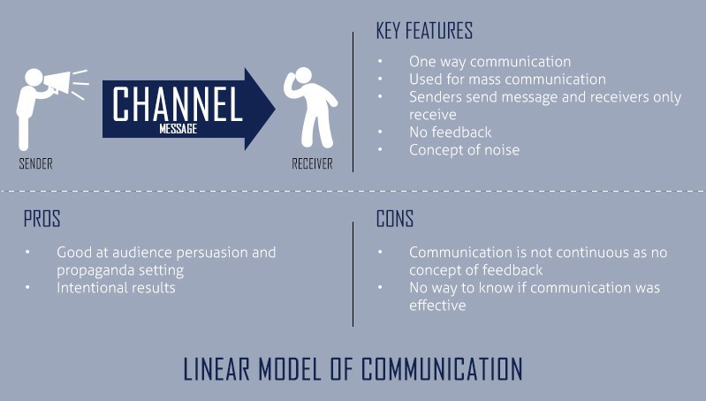
Linear Communication Model

Slide 43
Linear model has defined set of components required for a communication to be established where
Sender is the person who sends a message after encoding.
Encoding is the process of converting the message into codes compatible with the channel and understandable for the receiver.
Decoding is the process of changing the
encoded message into understandable language by the receiver.
Message is the information sent by the sender to the receiver.
Channel is the medium through which the message is sent.
Receiver is the person who gets the message after decoding.
Noise is the disruptions that are caused in the communication process in channel or in understandability of the message.

Slide 44

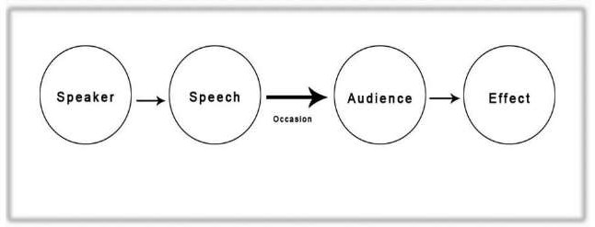
ARISTOTLE MODEL
☑By Aristotle(384-322 B.C) Greek philosopher and writer born in Stagira, Northern Greece. He studied physics, logic, mathematics, etc.
☑Aristotle developed a linear model of communication for oral communication known as which is considered as the 1st model of communication. It is most widely used communication model.

Slide 45
ARISTOTLE MODEL
Aristotle Model is mainly focused on speaker and speech. It can be broadly divided into 5 primary elements: Speaker, Speech, Occasion, Audience and Effect.
It is a speaker centred model as the speaker has the most important role in it. It is the speaker’s role to deliver a speech to the audience. The role of the audience is passive, influenced by the speech. This makes the communication process one way, from speaker to receiver.
☑The speaker must organize the speech beforehand, according to the target audience and situation (occasion). The speech must be prepared so that the audience be persuaded or influenced from the speech.

Slide 46
ARISTOTLE MODEL
To develop public speaking skills and create a propaganda and is speaker oriented and focuses on audience interaction in communication, there is no concept of feedbacks.
E.g. a politician (speaker) gives a speech to get votes from the civilians (audience) at the time of election (occasion). The civilians only vote if they are influenced by the things the politician says in his speech so the content must be very impressive to influence the mass and the speaker must design the message very carefully.
☑The speech must be clear as well as the speaker must have a very
good non-verbal communication with the audience like eye contact.

Slide 47
ARISTOTLE MODEL
Critical Elements of a Good Communicator
Ethos: Features that makes you credible in front of the audience. (Corrupt politician vs. Good politician).
Pathos: What you say is important for emotional bonds. If people of a village needs water and the politician says he’ll build a dam for drinking water and irrigation.
Logos: Logos is logic. People find logic in everything. Use factual data in an awareness program will attract the audience’s attention and will make them believe in the need of awareness in the particular matter.
Criticisms of Aristotle’s Model of Communication: No concept of feedback, it is one way from speaker to audience. No concept of communication failure like noise & barriers. Only for public speaking.

Slide 48
In 1960, David Berlo postulated
Berlo's
(SMCR) Model
Sender-Message-Channel-Receiver
of Communication from
Shannon Weaver's Model of Communication (1949). He described factors affecting the individual components in the communication making the communication more efficient. This model also focuses on encoding and decoding which happens before sender sends the message and before receiver receives the message respectively.
Shannon Weaver’s Model

Slide 49
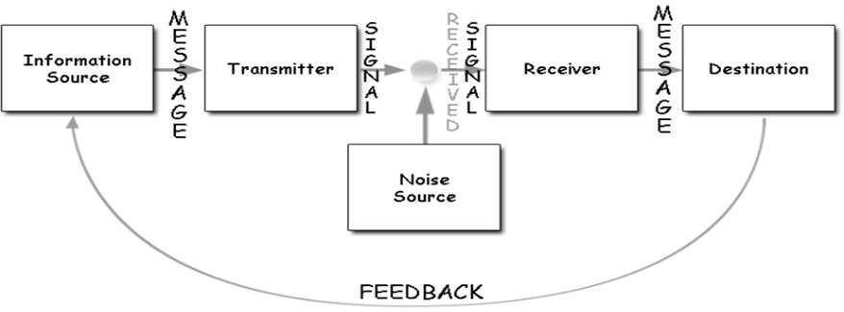
SHANONE AND WEAVER
☑Created in 1948 when Claude Elwood Shannon wrote an article “A Mathematical Theory of Communication” in Bell System Technical Journal with Warren Weaver. This is often called Telephone Model because it is based on the experience of having the message interfered with by “noise” from the telephone switchboard back in 1940s.
☑ Shannon was an American mathematician whereas Weaver was a scientist. This Model is Mother of all Models.

Slide 50

SHANONE AND WEAVER
There are 3 levels of problems of communication per Shannon Weaver.
Technical problem –How a channel causes a problem
Semantic problem –Is the meaning of message sent and received
very different
Effectiveness problem –How effectively does the message cause reaction
Concept of noise. 2 way process. Apply in general communication. Quantifiable. More for interpersonal communication than group communication and mass communication. Receiver plays the passive and sender plays the primary.

Slide 51
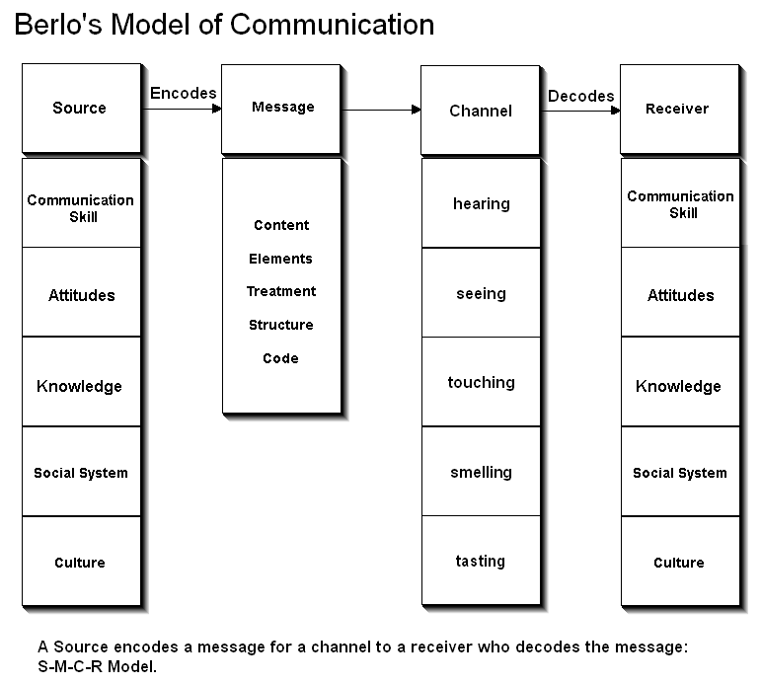

Slide 52
There is no concept of feedback, so the effect is not considered.
There is no concept of noise or any kind of barriers in communication.
It is a linear model of
communication, there is no two way communication.
Both of the people must be similar
according to all the factors mentioned above.

Slide 53
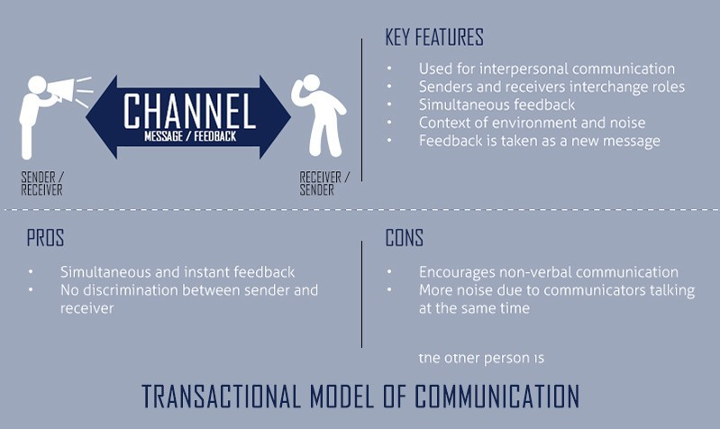
Transactional Communication Model

Slide 54

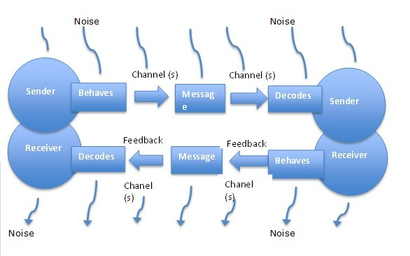

Slide 55
Without verbal response, the sender can not be sure that the receiver got the message as intended. Feedback is an important component in the communication process, especially in interpersonal communication as it gives a space to clarify misunderstandings.
The transactional model gives the opportunity for a lot of noise because the communication is simultaneous. For example, when many people are talking at the same time in a meeting, the objective of the meeting will not be fulfilled.

Slide 56
Differences Between Transactional and Other Communication Models
Other Models
Used for Intrapersonal, interpersonal, group or mass communications.
Transactional Model
Used for interpersonal communication
Includes the role of context and environment
Includes noise and communication barriers as factors
Talks about non-verbal communication
Role of context and environment are not mentioned in other models
Not necessarily have the concept of noise
Ignores non-verbal communication
Feedback comes later in interaction model and is not included in linear model
Simultaneous feedback

Slide 57
BARNLUND’S TRANSACTIONAL MODEL
Dean
Barnlund
proposed a transactional
model of
communication
in 1970 for basic which
interpersonal
communication
articulates messages
that sending and receiving of
happens simultaneously between people which is popularly known as Barlund's Transactional Model of Communication. The model has been further adapted and reformed by other theorists
as General Transactional
Model. trend
The model of linear
shifted from the model to dynamic and two model.
way communication

Slide 58
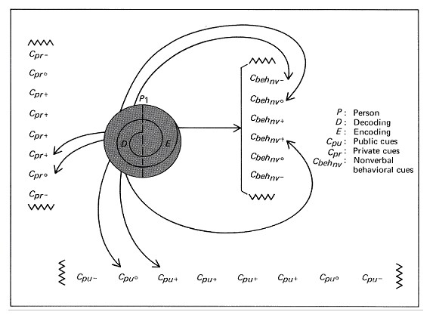
BARNLUND’S TRANSACTIONAL MODEL
☑
☑
☑
☑
☑
Multi Layered Feedback system Public cues – Environment Private cues – Senses Behavioural cues – Non Verbal
Shared field experience of the sender & receiver. Simultaneous message sending, noise & feedback.
Complex. Both must understand codes


Slide 59
Barnlund’s model is very complex.
Both the sender and receiver must understand the codes sent by the other. So they must each possess a similar "code book". (The concept of code book is not mentioned in the model but understood.)

Slide 60

Interactive model (also known as convergence model) deals with exchange of ideas and messages taking place both ways from sender to receiver and vice-versa.
The communication process take place between humans or machines in both verbal or non-verbal way. This is a relatively new model of communication for new technologies like web.

Slide 61
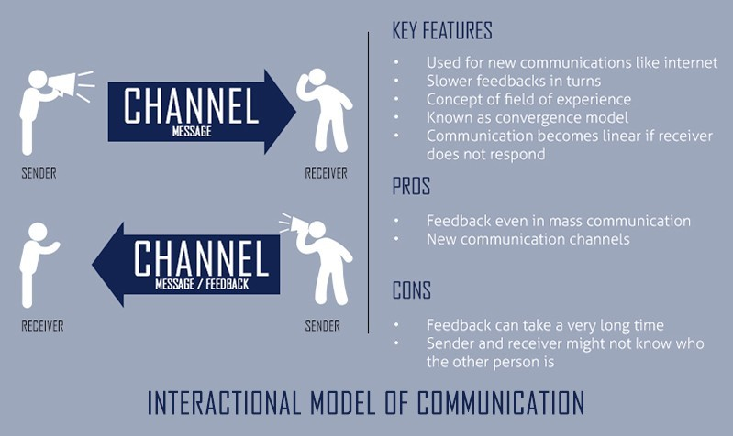

Slide 62
In Interactive model, whenever a source sends a message to a receiver (source), he/she encodes the message first. The encoded message is then received by the receiver where it is decoded to get the original information. Again, the receiver acts as a source, encodes another message (also knows as a feedback) and sends it back to the sender.

Slide 63
Interactive Model and Other Models Differences
Interactive Model of Communication
Indirect and slow feedback
Feedback is a whole new process of communication
For new media
No engagement of sender and receiver in communication Sender and receiver is equally important
It can become linear if the receiver does not respond
Other Models of Communication
Direct and fast feedback
Feedback is the part of a single communication process
For all other kinds of media like print, news, etc.
Engagement of sender and receiver in communication
Sender is important and overpowering than receiver
The receiver is bound to give some kind of response verbal or non- verbal

Slide 64
Schramm’s Model of Communication
An example of Interactive model is that of Wilbur Schramm, who is considered the Father of Mass Communication. He came up with five models, but the Schramm Model in (1995) we are concerned with is the concept that explains why communication breakdown occurs. Schramm asserts that communication can take place if and only if there is an overlap between the Field of Experience of the Speaker and the Field of Experience of the Listener.

Slide 65
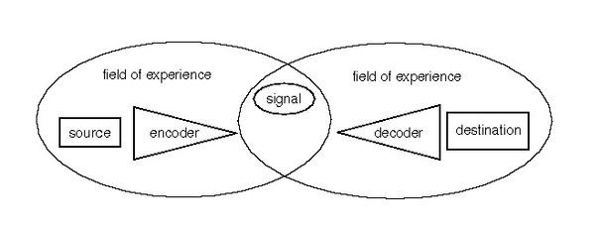
Schramm’s Model of Communication

Slide 66
Circular communication gives opportunity to both parties to give their opinion.
As it is dynamic and ever changing model, it is helpful in general practice.
Sender and receiver interchanges and both are equally active.
Semantic noise included as a concept helps in understanding problems that can occur during interpretation of message.

Slide 67
Feedback makes it easier to know if
the message is interpreted by the receiver as intended or not.
Concept of interpretation makes the communication effective.
Field of experience (psychological effect) helps to understand the communication
process in many other ways than the traditional ones..
Concept of context makes the environmental factor be included in interpretation of message and brings change in the message

Slide 68
This model can not deal with multiple levels of communication and complex communication processes.
There can only be two sources communicating, many sources complicates the process and the model can not be implemented.
Message sent and received might be interpreted differently than intended.

Slide 69
Verbal and non-verbal communication

Slide 70
VERBAL COMMUNICATION
It means communicating with words, written or spoken. Verbal communication consists of speaking, listening, writing and reading
People spend 85% of their working time in communication. Of this:
9% in writing
16% in reading
30% in speaking
45% in listening.
Verbal Communication Nonverbal Communication
Oral Spoken Language Laughing, Crying, Coughing, etc.
Non Oral Written Language/Sign Language Gestures, Body Language, etc.

Slide 71
Types of Verbal (Oral) Communication
Face to face communication
Telephonic conversation
Public Speech
Presentation
Interview
Negotiation
Group Discussion
Meeting

Slide 72
CHARACTERSTICS OF EFFECTIVE VERBAL COMMUNICATION
Consider the objective
Be sincere
Use simple language, familiar words
Be brief and precise
Use polite words and tone
Say something interesting and pleasing

Slide 73
MERITS
More personal and informal
Makes immediate impact
Provides opportunity for interaction and feedback
Help us correct ourselves (our messages according to the feedback and non-verbal cues from the listener)
It is fastest and less expensive

Slide 74
DEMERITS
It can be quickly forgotten.
A word once uttered cannot be taken back
There is no legal evidence of oral communication
Impact may be short lived
Very difficult to be conscious of our body language

Slide 75
BARRIERS TO EFFECTIVE VERBAL COMMUNICATION
STATUS- formal and informal status levels affects effectiveness of face to face communication
COMPLEXES- lack of confidence or sense of superiority.
ABSTRACTING- it is partial and selective listening, leading to loss of information
LANGUAGE BARRIER- listener should be familiar with the language used by the speaker.

Slide 76
NONVERBAL
COMMUNICATION
Nonverbal communication includes all unwritten and unspoken messages, both intentional and unintentional.

Slide 77
FEATURES :
Non verbal communication flows through all acts of speaking or writing.
They are the wordless messages .
Is a creative activity , which comes through stimuli
produced by the mind.

Slide 78
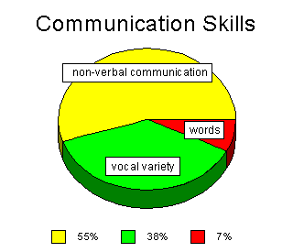
Importance of non-verbal communication
A person to have quality communication skills must possess the knowledge of non-verbal communication.
As compared to words and vocal variety non-verbal communication matters a lot.

Slide 79
TYPES OF NON VERBAL COMMUNICATION
Kinesics communication Meta communication
-Body language.
-through words, depicting alternate meaning.
-includes behavior.
-shows latent meaning.

Slide 80
Types of non verbal communication
1.
Body Language:
Appearance
Facial expressions
Smile
Eye contact
Voice
Energy
Space h.Time
2.
Paralanguage
3.
Sign Language:
Signs
Symbols
Signals
Postures and Gestures
4.
5.
Attire

Slide 81
Paralanguage
The non verbal aspects of the spoken words are known as paralanguage.
The non verbal elements of communication used to convey an emotion, attitude and an altered meaning are referred to as paralanguage.
Its elements include:
Tone
Volume
Pitch
Speed
Pronunciation
-Intonation

Slide 82
Paralanguage
Tone is the quality of the voice.
Volume is the loudness or softness,
Pitch is the high or low note on the scale , a high pitched voice is often unpleasant
Speed is factor of speech.
Rapid speech indicates excitement

Slide 83
Paralanguage
Pronunciation means the accepted standard of the way in which a word is said.
Correct and clear pronunciation is important
Accent is the way a person pronounces the sound of the language, every language has its own accent
We carry our mother tongue accent to other languages we learn.
Intonation is the sound pattern of sentences

Slide 84
Paralanguage
Silence can be a very effective way of communication.
Silence is a difficult method of communication to use as it takes a good deal of self control
Short pauses are used to emphasize a point.
Thus “Paralanguage” involves sounds like hushing , whistling and hissing and speech alterations , like voice quality , rate of speech, hesitations etc.

Slide 85
Sign Language
Sign :
-A sign is a mark traced on a surface or an object with a view o indicate a particular meaning.
A sign may give out an information , instruction or warning.
It may also be a gesture , a movement or sound to convey something specific.
E.g. Priests and elders convey their blessings by placing their hands on the heads of the people bowing to them.( Sign of blessings)
-E.g. Finger on the lips to suggest “ Keep Silent”.
Such signs are sometimes group specific and are accepted as a matter of convention.
A sign may also relate to a written mark conventionally used to convey a specific meaning.
Such signs may be general as in case of road and traffic signs or subject specific signs , specific to a profession E.g. mathematics , algebra etc.

Slide 86
Sign Language
Signal :
A signal is a sound or a movement that people make to give others information , instruction or warning.
A signal is also understood as an indication that something exists or something is about to happen.
E.g. signal to the waiter for a bill, signal to turn right.
Signs and signals are often used with very similar meanings.
However there is a difference: A sign is something that we find or see , whereas a signal is generally used for something that is done intentionally and suggests that some action be taken in response.
Signs and signals may be explicit or in code language.
Awareness ad understanding of signs and signals makes communication more meaningful.

Slide 87
Sign Language
Symbol :
A symbol refers to a manner of representation of ideas.
Symbols often use the power of association to convey a specific meaning.
In modern day business , the use of a logo is also very common.
A logo is a printed design or symbol that a company or organization uses as its specific sign.
Here are some examples of the use of symbol:
WHITE : Symbol of purity
LION : Symbol of strength
ISI Mark : Symbol of quality
Use of symbols at the right places enhances the effectiveness of the communication.
40 mph – Speed limit of 40 miles per hour.
- = - Equal to

Slide 88
Postures and Gestures
Posture:
Posture is the way we hold ourselves , the way we stand or sit.
It indicates something about our feelings and thoughts, attitudes and health.
Posture refers to the carriage , state , attitude of body or mind.
Stiff posture shows tension , comfortably leaning back conveys a relaxed mood.
Posture can indicate disregard or disrespect for others.
Graceful posture is a great asset in any business scenario.
Four types of postures can be easily identified:
Forward lean indicated attentiveness and interest.
Drawing back or turning away , expresses a negative or refusing
Expansion suggests “proud” , “conceited”, “arrogant”.
Forward leaning body , bowed head , drooping shoulders and sunken chest usually convey “depressed” , “downcast”.
Postures express attitudes , feelings and moods more clearly.

Slide 89
Postures and Gestures
Gesture:
Gestures are movements of hands / head / body ;they are a natural accompaniment of speech.
Gesture refers to any significant movement of limb or body and a deliberate use of such movement as an expression of feeling.
Gesture can also be understood as step calculated to evoke response from another person or to convey intention.
People read and interpret gestures therefore these are extremely important in organizational context.
A person who does not make any movement while speaking appears somewhat stiff and mechanical.

Slide 90
Attire
Attire or dress is another important aspect of non verbal communication.
The way a person dresses is often subjected to much interpretation.
Attire proclaims a person.
Appropriateness for the occasion is essential , the formality of the occasion , the time of the day, the season , the cultural background of the people who will be present and the conventions of your own organization should provide good guidance.
Formal , informal or casual dressing conveys different meanings.
Important and ceremonial occasions normally call for a formal dress.
Organizations mostly have their dress codes.

Slide 91
Speech and Writing

Slide 92
Types of Speech Communication
Informative – This speech serves to provide interesting and useful information to your audience. Some examples of informative speeches:
A teacher telling students about earthquakes
A student talking about her research
A travelogue about the Statue of Unity
A computer programmer speaking about new software

Slide 93
Types of Speech Communication
Demonstrative
– This has many similarities with
an informative speech. A demonstrative speech also teaches you something.
The main difference lies in including a demonstration of how to do the thing
you’re teaching. Some examples of demonstrative
speeches:
How to start your own blog
How to bake a cake
How to write a speech

Slide 94
Types of Speech Communication
Persuasive – A persuasive speech works to convince people to change in some way: they think, the way they do something, or to start doing something that they are not currently doing. Some examples of persuasive speeches:
Become an organ donor
Improve your health through better eating
Television violence is negatively influencing
our children
Become a volunteer and change the world

Slide 95
Types of Speech Communication
Entertaining — The after-dinner speech is a typical example of an entertaining speech. The speaker provides pleasure and enjoyment that make the audience laugh or identify with anecdotal information. Some examples of entertaining speeches:
Excuses for any occasion
Explaining cricket to an American
Things you wouldn’t know without the movies

Slide 96
Levels of Speech Communication
Intrapersonal Communication
Interpersonal Communication
Public Communication
Mass Communication
Group Discussion

Slide 97














































What is Written
Communication ???
Written communication has great
significance in today’s business world.
It is an innovative activity of the mind. Effective written communication is essential for preparing worthy promotional materials for business development.
Speech came before writing.
But writing is more unique and formal than speech.

Slide 98















































Effective writing involves careful choice of words, their organization in correct order in sentences formation as well as cohesive composition of sentences.
Also, writing is more valid and reliable than speech. But while speech is spontaneous, writing causes delay and takes time as feedback is not immediate.

Slide 99








Types of Written
Communication

Slide 100

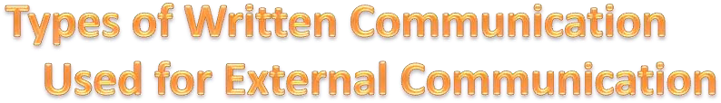












Electronic Mail
Internet Websites
Letters
Proposals
Telegrams
Faxes
Postcards
Contracts
Advertisements
Brochures

Slide 101









Memos
Reports
Bulletins
Job descriptions
Employee manuals
Electronic mail

Slide 102



Importance of Written
Communication…
Written communication usually requires
more thought and effort than any other modes of communication.
Writing must be concise, informative and easy to read as both an informative and instructional tool.
The importance of written communication in business is evident by the plethora of forms, manuals and materials that companies publish each day.

Slide 103

















































Written communication can take the form of legal documents or manuals.
For example :- OSHA (Occupational Safety and Health Administration) outlines health and safety policies and procedures for industrial and commercial businesses. These documents ensure clarity among employees and minimize the chance for any misunderstanding.

Slide 104
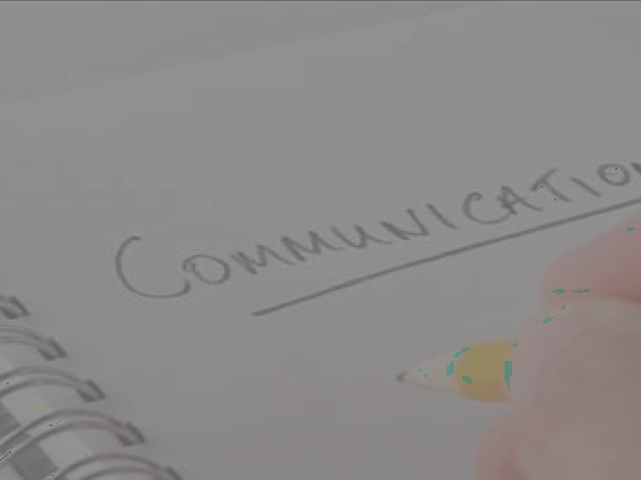







































































Written communication is also important for instructing employees on certain tasks and projects.
For example :- A boss may meet with an employee about a special project. She may hand the employee a list of tasks she wants completed for the day. The written instructions may inform the employee whom to contact for certain information. The boss may also indicate which items are most important so the employee can prioritize his tasks.

Slide 105
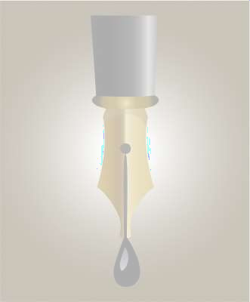































































Company managers | must | use written
communication in the | form | of reports or
presentations.
For example
:- A marketing research
manager will often analyze results from a
survey in a report. She recommend certain strategies
may also for upper
management, based on consumer needs and preferences. Written presentations are an effective means of providing key information to other departments.

Slide 106














































Written communication is also important for business advertising. Small companies need to promote their businesses to potential consumers and business customers. Written advertisements include direct mail pieces such as sales letters and brochures, magazine display ads, fliers, Internet ads and catalogs.

Slide 107





























































Email is an extremely important written communication tool used in business. Employees write multiple emails each day, setting up meetings or apprising bosses about the status of projects. The email is often used as an information tool after a meeting. Managers can sum up the key points of a meeting, then confirm follow-up assignments or tasks with email recipients.

Slide 108



Slide 109







































You may think complex sentences make you sound impressive, but they can prevent your ideas from getting across. Use “during” instead of “during the course of.”
Don’t say, “Is it possible to meet with you and your husband at your earliest possible convenience in order to discuss the matter of listing your home for sale with me and my company?” Instead, say “When may I talk with you and your husband about listing your home?”

Slide 110

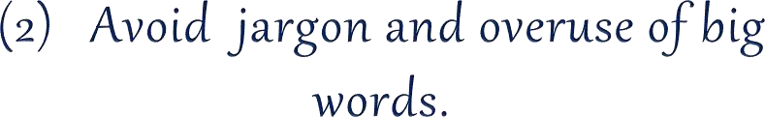













Sometimes you need a complex word or phrase to express your ideas clearly. But if a shorter word can do the job, use it instead.
Use “speed up” instead of “expedite.”
Use “plan” instead of “strategize.”
Use “assume” instead of “postulate.”
Use “use” instead of “utilization.”
Use “try” instead of “endeavor.”
Use “sent” instead of “transmitted.”

Slide 111

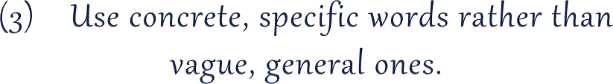



















For example,
say, “I have sold three
houses in your neighborhood in the last year,” instead of “I’ve worked with several people in your neighborhood.”

Slide 112
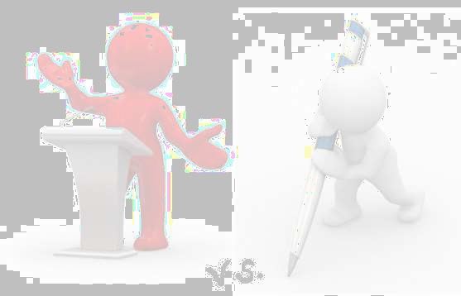





Ask yourself, how would I say it if the reader were sitting across the desk from me? Use contractions where appropriate; use the words “you,” “me,” “us,” and “I” to make your writing more people- oriented.TIP: Keep a file of the best- written letters, memos and reports that you have received and model your writing after them.

Slide 113

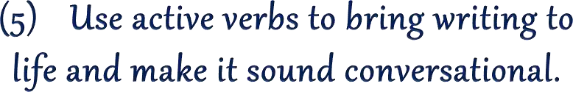















In talking we almost always use active verbs: “Jackson hit a line drive to center field.” But in business, we too often say: “A line drive to center field was hit by Jackson.”

Slide 114

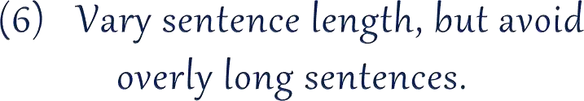




Try for an average sentence length of 17 words. Introduce no more than one or two ideas per sentence.

Slide 115

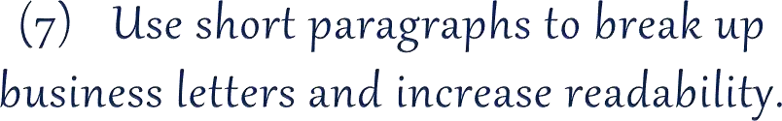
The
average paragraph in a business
letter is two sentences long. Long paragraphs often contain more than one idea and can be split so that each idea has its own paragraph.

Slide 116










Although
it’s grammatically correct to
use the male pronoun, “his,” when referring to both sexes, this may offend some people. Make sentences plural to eliminate this problem. “Associates should turn in their call reports weekly.”

Slide 117
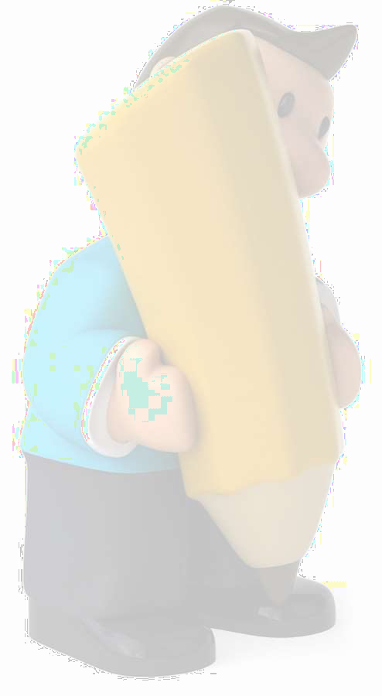
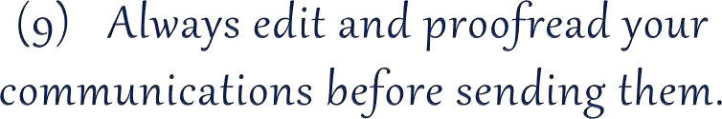


Remember “Spell Check” doesn’t catch everything. And don’t forget to check all
property name spellings;
the checker will miss and incorrect
computerized spell them. Misspellings
grammar reflect poorly on you and your company.

Slide 118














Establishing the right tone
in written difference
communications can make the
between a positive response and a hostile one. To help create a positive tone : Avoid “I.” Instead use “you” as the subject of sentences to get the reader involved.
Words with negative connotations include: delay, doubt, difficult, fail, problem.
Words with positive connotations include: glad, improvement, service, happy,

Slide 119




How to Improve Writing
Skills…

Slide 120
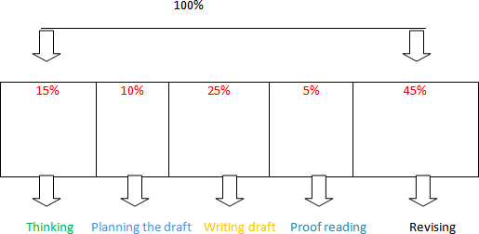

Slide 121






Slide 122










More accurate
that is errors can be
corrected or content approved before message is sent.
A physical record of the communication is made.
Documentation exists to refer back to when necessary.
Written communication is more precise and explicit.

Slide 123







It provides ready records and references.
Legal defences can depend upon written communication as it provides valid records.
Effective written communication develops and enhances an organization’s image.

Slide 124











Written communication takes time.
More expensive to prepare. It costs huge in terms of stationery and the manpower employed in writing/typing and delivering letters.
No immediate feedback.
Less personal.

Slide 125












Also, if the receivers of the written message are separated by distance and if they need to clear their doubts, the response is not spontaneous.
Effective written communication requires great skills and competencies in language and vocabulary use.
Too much paper work and e-mails burden is involved.

